Slide 1
CS w186 Introduction to Database Systems
Prof. Joe Hellerstein
Operated this semester by:
Prof. Josh Hug
Lakshya Jain

Slide 2
Essential Queries
Why take this class?
What is this class all about?
Who is running this?
How will this class work?

Slide 3
Why? Reason #1: Utility
This class is very, very useful
Data processing backs essentially every app
Databases of one form or another back most apps
The principles taught in this class back nearly everything in computing

Slide 4
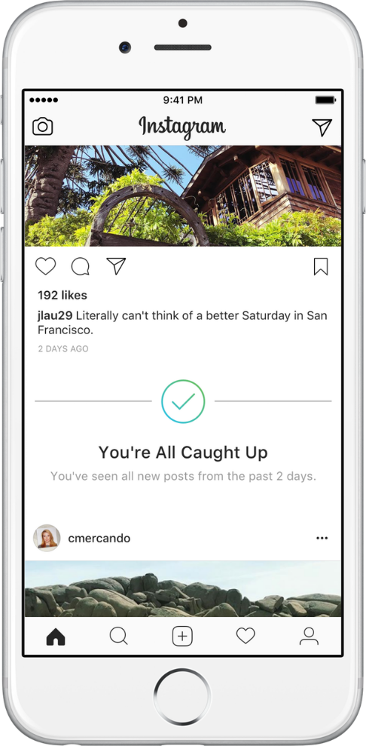
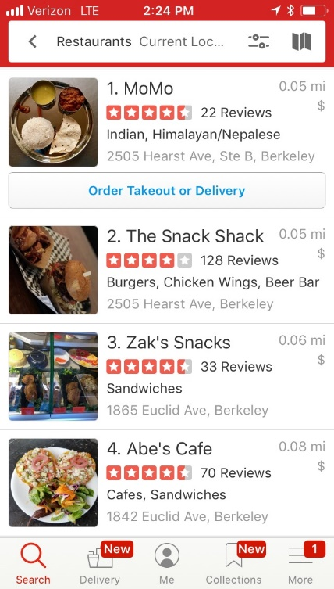
Where shall I eat, Database?
Each ratings star added on a Yelp restaurant review translated to anywhere from a 5% to a 9% effect on revenues.
—Harvard Business School, 2011
http://hbswk.hbs.edu/item/the-yelp-factor-are-consumer-reviews-good-for-business

Slide 5
What am I missing, Database?
https://blog.bufferapp.com/instagram-analytics
https://instagram-press.com/blog/2018/07/02/introducing-youre-all-caught-up-in-feed/

Slide 6
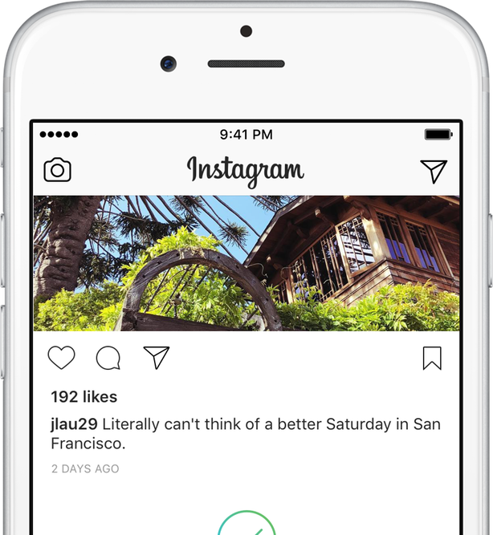
What am I missing, Database?
Hey Instagram: that’s Chez Panisse in Berkeley, CA!

Slide 7
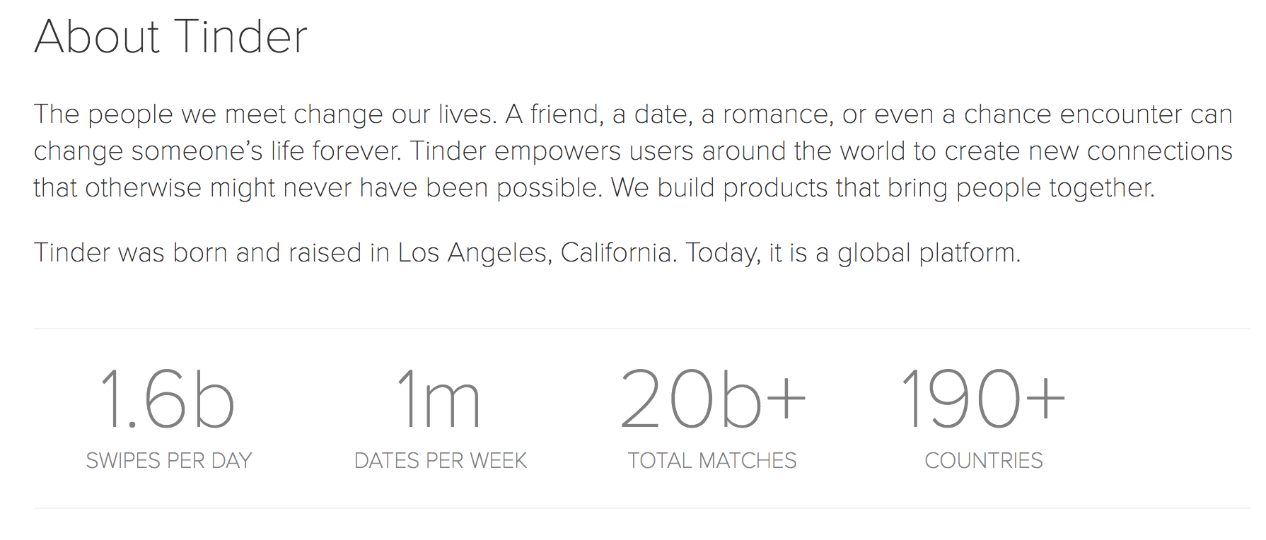
Who should I be with, Database?
https://www.gotinder.com/press
https://www.awesomeinventions.com/funny-tinder-profiles/

Slide 8
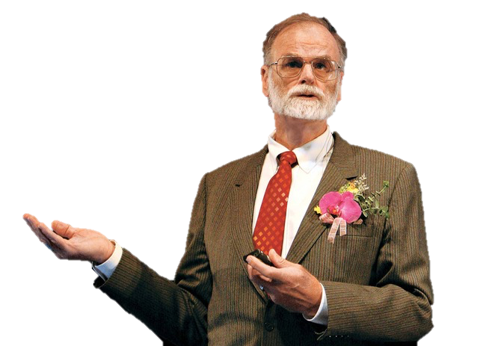
How does Science work? Database.
Jim Gray
Turing Award Winner
First Berkeley CS PhD

Slide 9
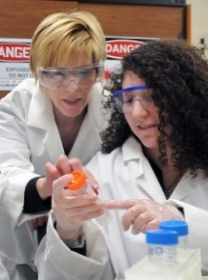
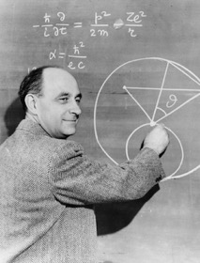
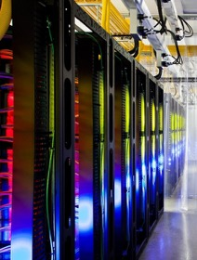
How does Science work? Database.
Experimental
Theoretical
Simulation
Data
Intensive

Slide 10

Astronomy in the 4th Paradigm
+
Sloan Digital
Sky Survey (SDSS)
Sky Server
Database
Systems

Slide 11
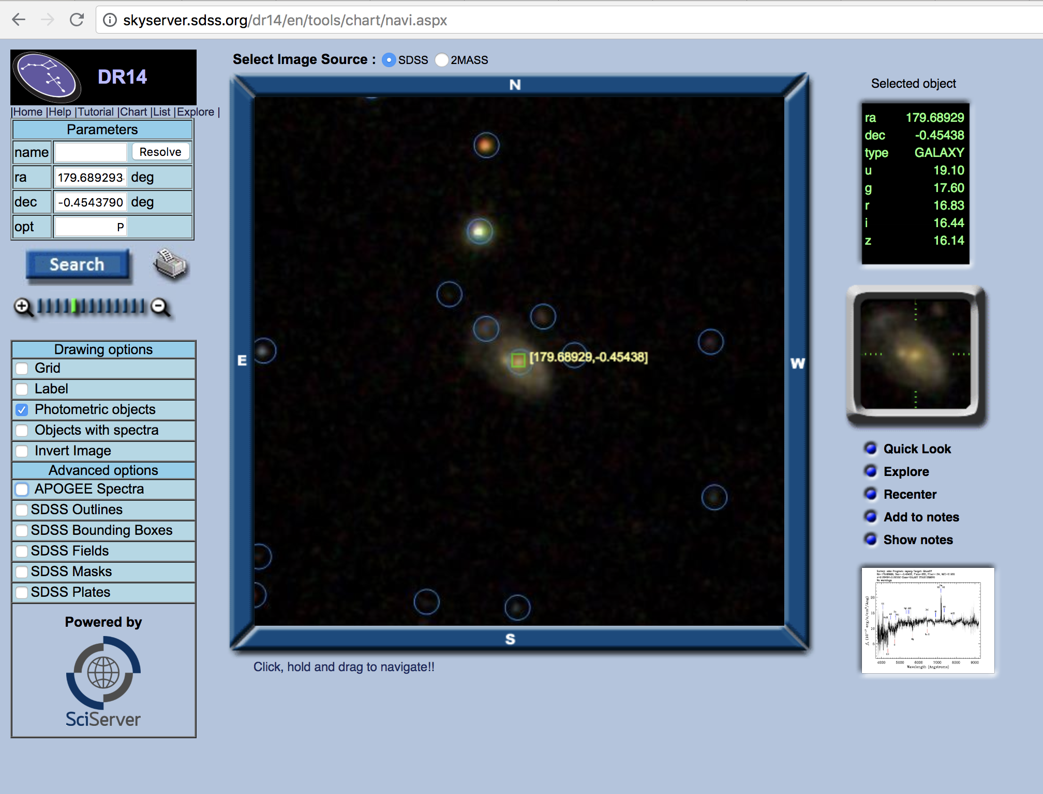
http://skyserver.sdss.org

Slide 12
Science in the 4th Paradigm
http://www.sciserver.org/
Cosmological
Physics
Astronomy
Connectomics
Genomics
Oceanography

Slide 13
Your career…
The fundamentals of this class are (and will remain) central to participating in this new and more data-centric world
Many of the details and technologies will change in the coming years
Be prepared to generalize from what you learn here
Keep learning new things

Slide 14
Why? Reason #1: Utility
This class is very, very useful
Data processing backs essentially every app
Databases of one form or another back most apps
The principles taught in this class back nearly everything in computing
This material will empower you.

Slide 15
Why? Reason #2: Centrality
Data is at the center of modern society
Data is unique in its nature and significance
Particular and voluminous
Often asymmetric
low value in isolation, high value when aggregated
Difficult to protect

Slide 16
At the center of major issues
Privacy
National Security
Online Misinformation (including Fake News)

Slide 17
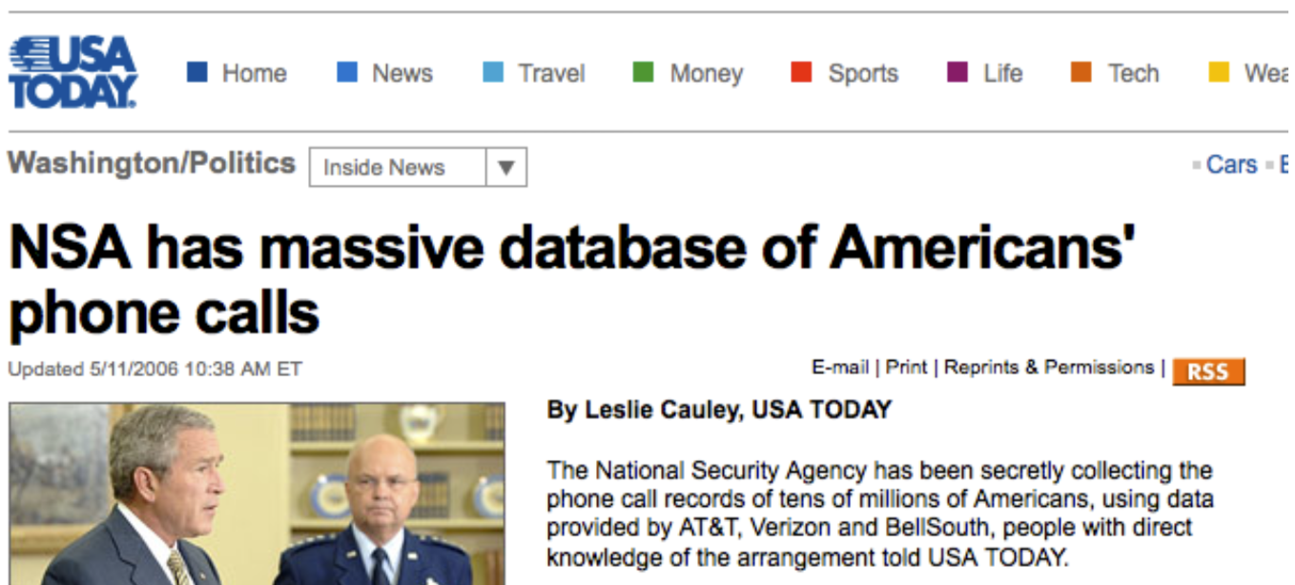
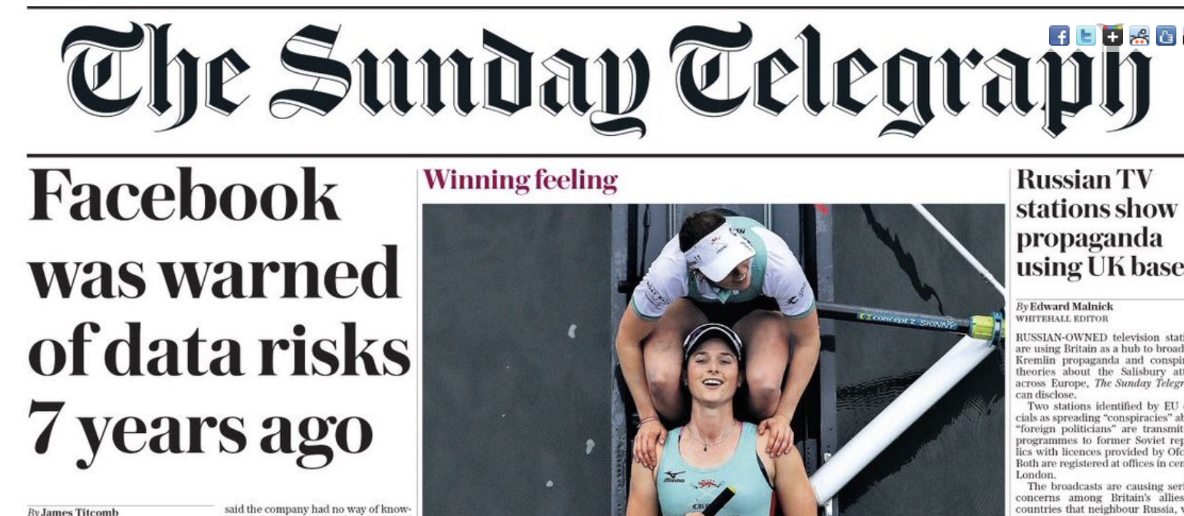
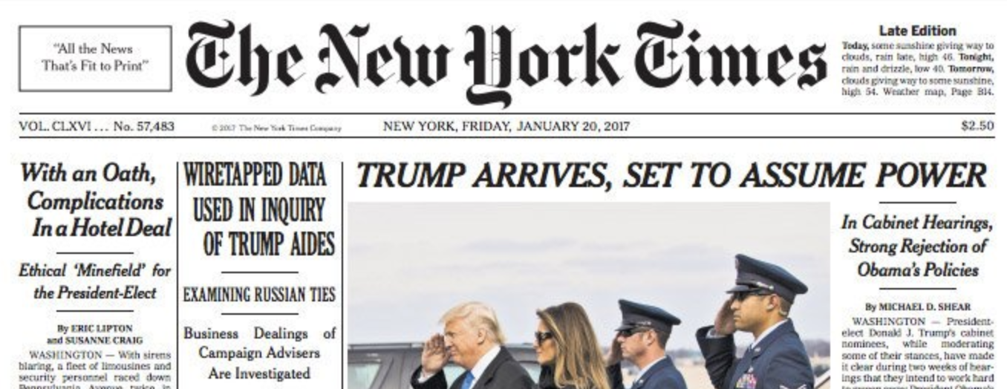
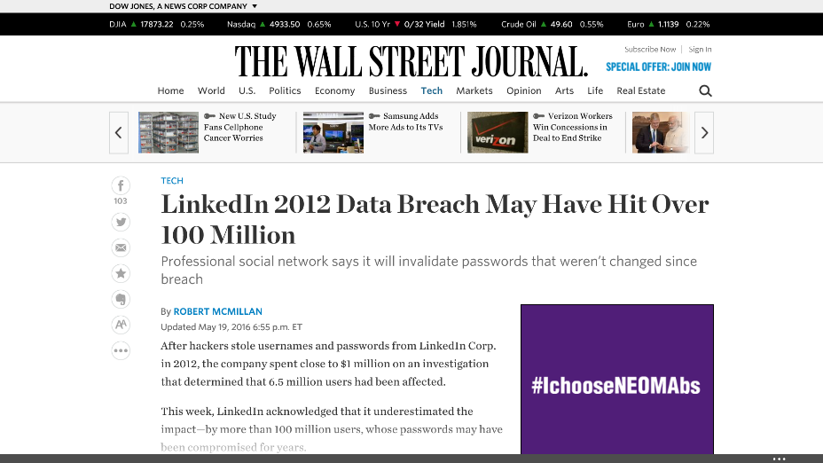
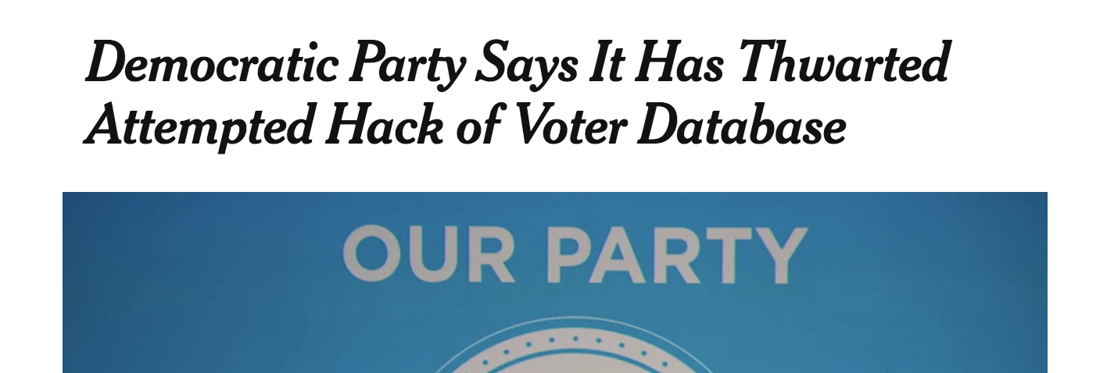

Slide 18
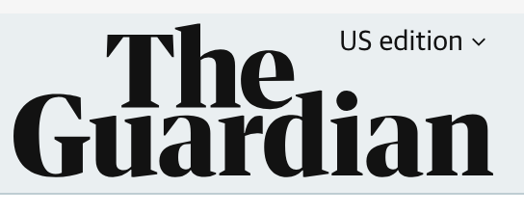
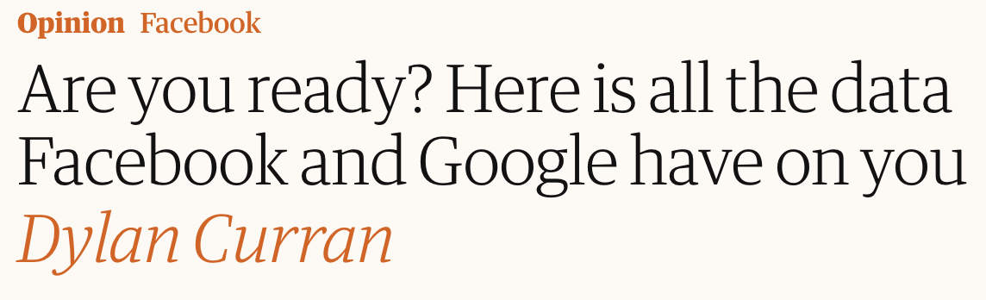
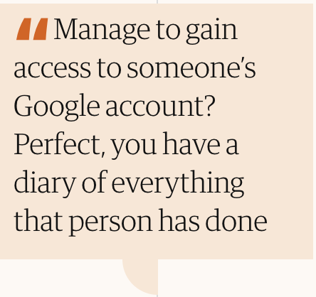

Slide 19
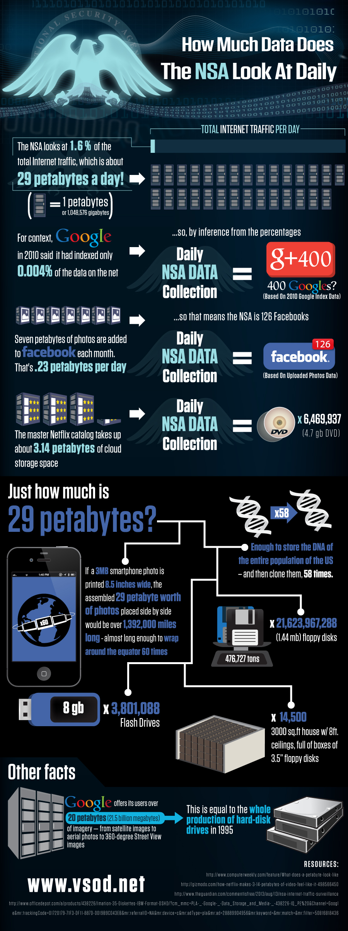
National Security Data: 2010
Notes:
Numbers from the guardian
Xkeyscore is latest system (built on federated MySQL servers) replaced Marianas

Slide 20
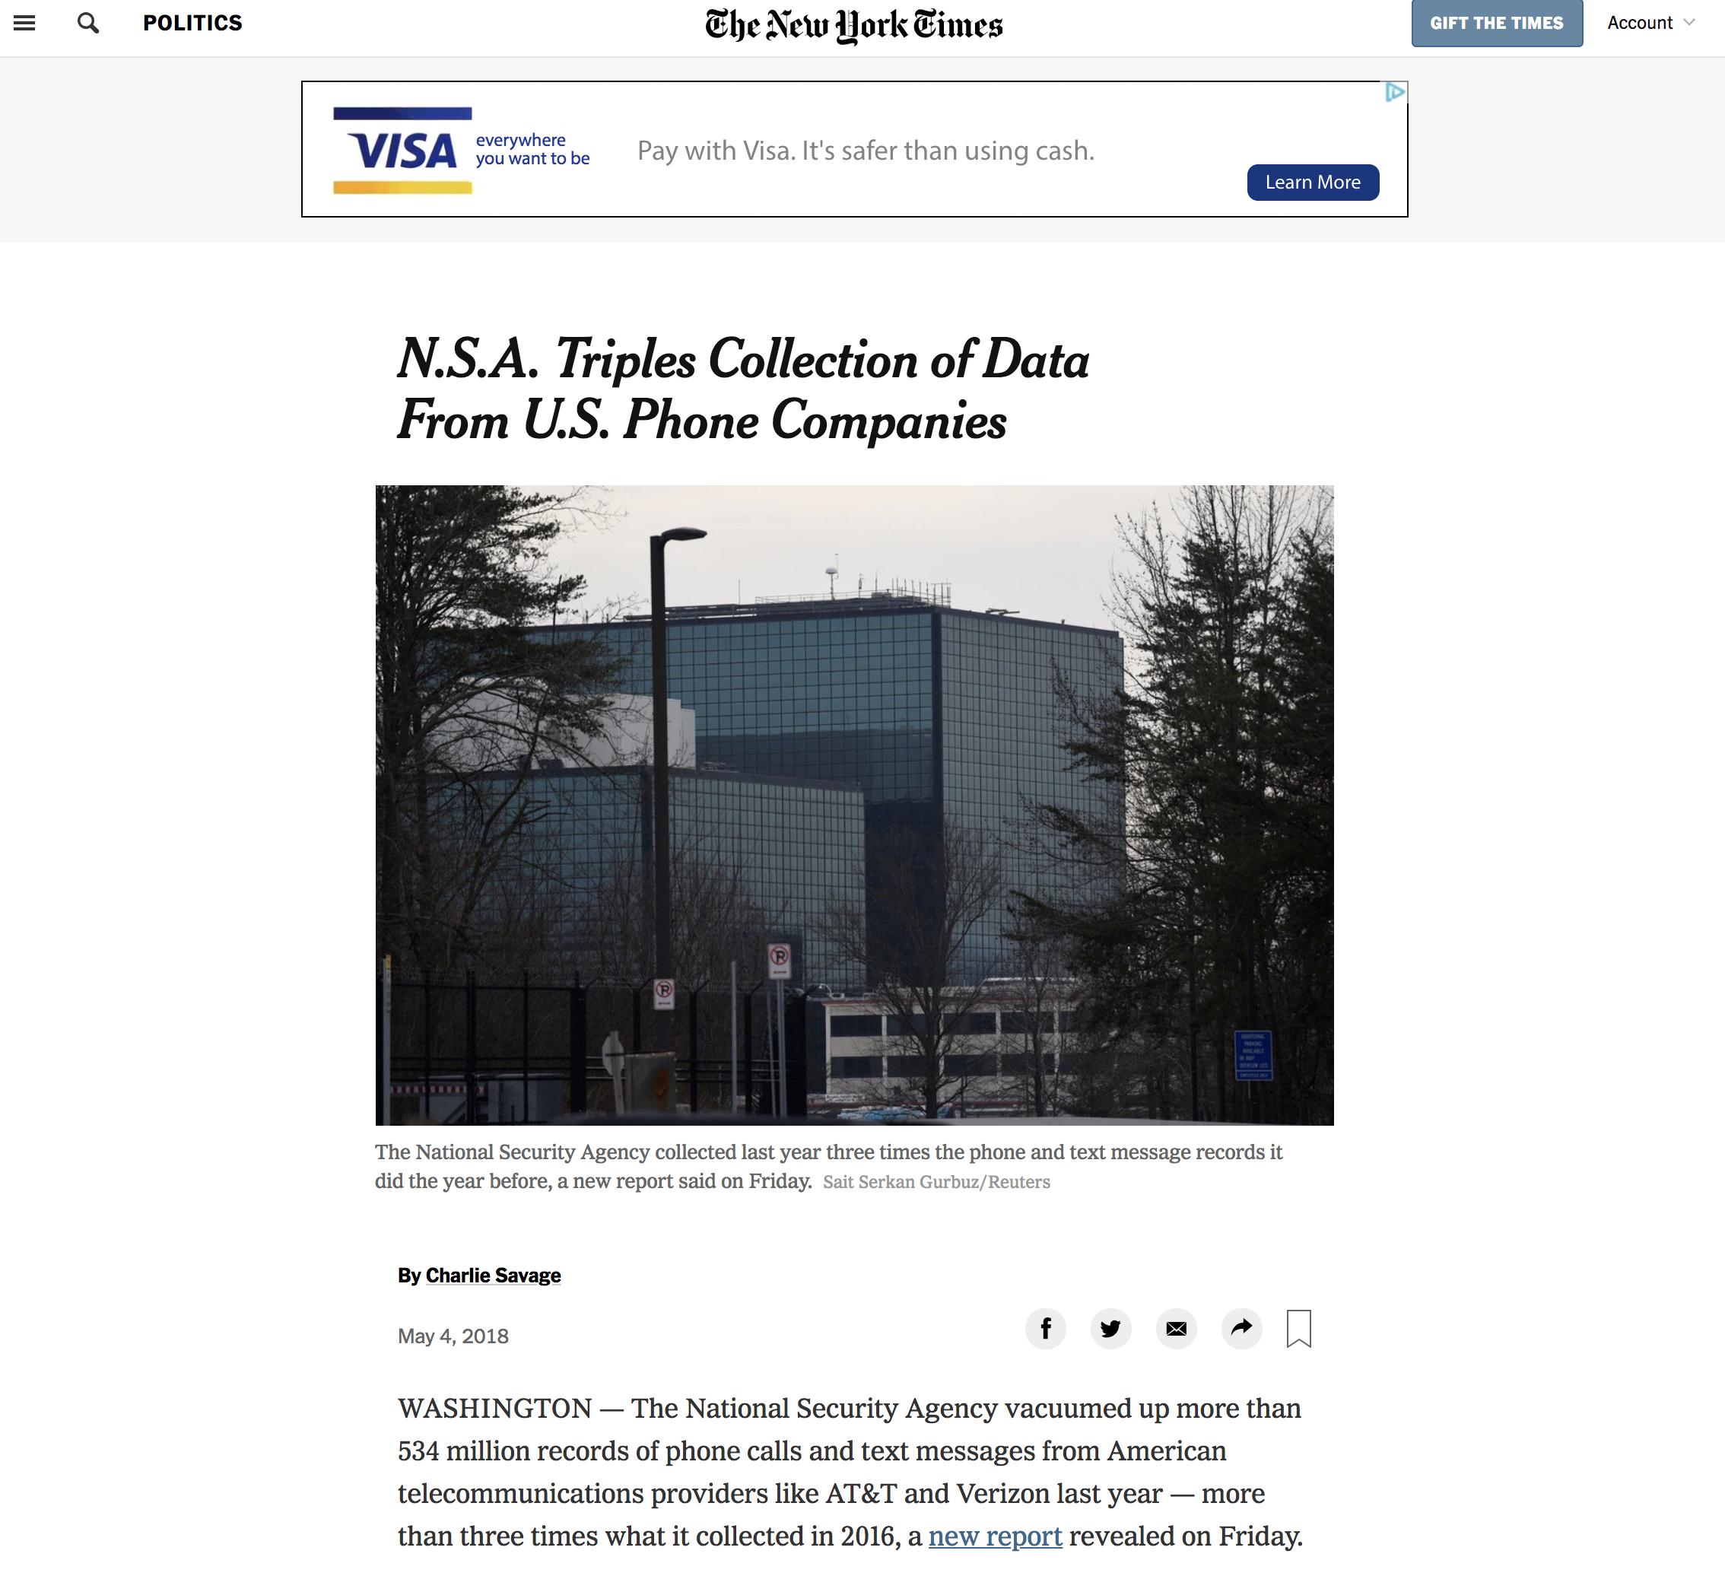
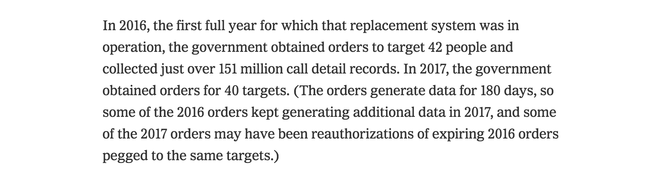
National Security Data: 2018

Slide 21
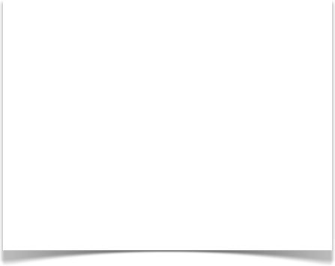
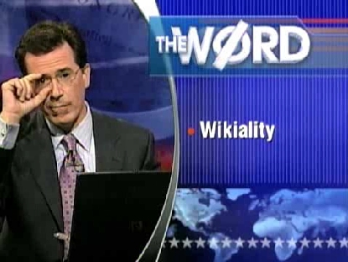
Data Integrity: Not all Data is Correct
“Any user can change any entry, and if enough users agree with them, it becomes true.” – Colbert Report 7/31/2007
Asked viewer to update the page on Elephants to reflect a tripling population, forcing Wikipedia to lock the page.
Yet a 2005 Nature study found Wikipedia science articles to be similar in accuracy to Encyclopedia Britannica.
COMEDY CENTRAL VIDEO ARCHIVE VIA WIKIPEDIA
http://www.cc.com/video-clips/z1aahs/the-colbert-report-the-word---wikiality
https://en.wikipedia.org/wiki/Reliability_of_Wikipedia
http://www.nature.com/nature/journal/v438/n7070/full/438900a.html

Slide 22
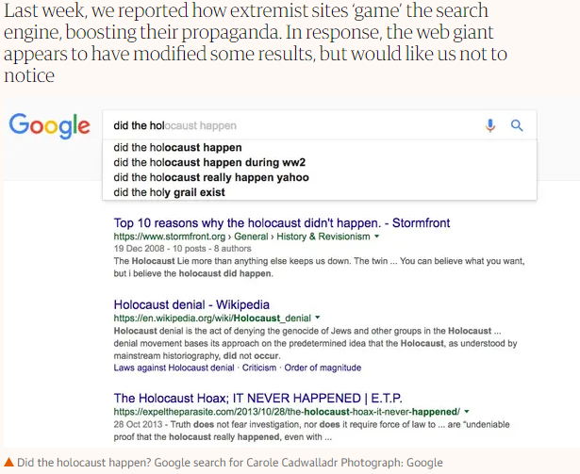
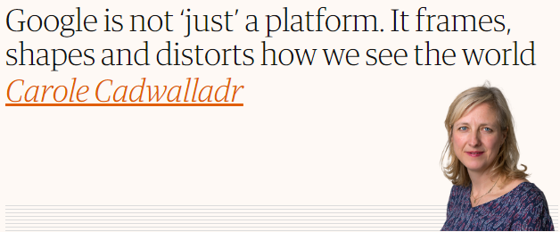
Data Integrity: Not all Data is Correct
(From the Guardian, Dec 2016)

Slide 23
A Syllogism of Quotes
“information is knowledge”
— Albert Einstein
“knowledge is power”
— Sir Francis Bacon
“with great power comes great responsibility”
— Uncle Ben (Spiderman)

Slide 24
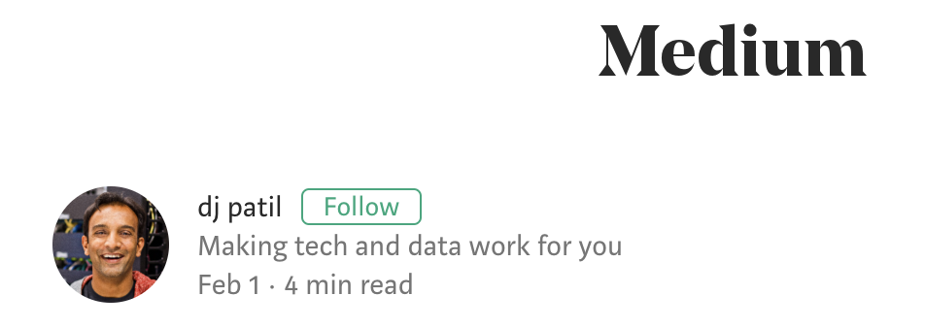
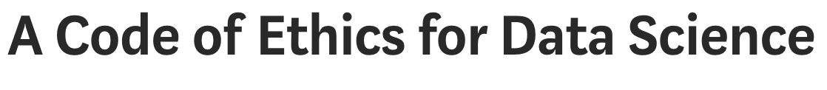
“I could go on and on about all of the amazing work that is happening around the world using data to make lives better everyday, but we also have to address where data is causing more harm than good.”
“Data is such an incredible lever arm for change, we need to make sure that the change that is coming, is the one we all want to see.
So how do we do it? First, there is no single voice that determines these choices. This MUST be community effort.”
https://medium.com/@dpatil/a-code-of-ethics-for-data-science-cda27d1fac1
https://www.oreilly.com/ideas/doing-good-data-science

Slide 25
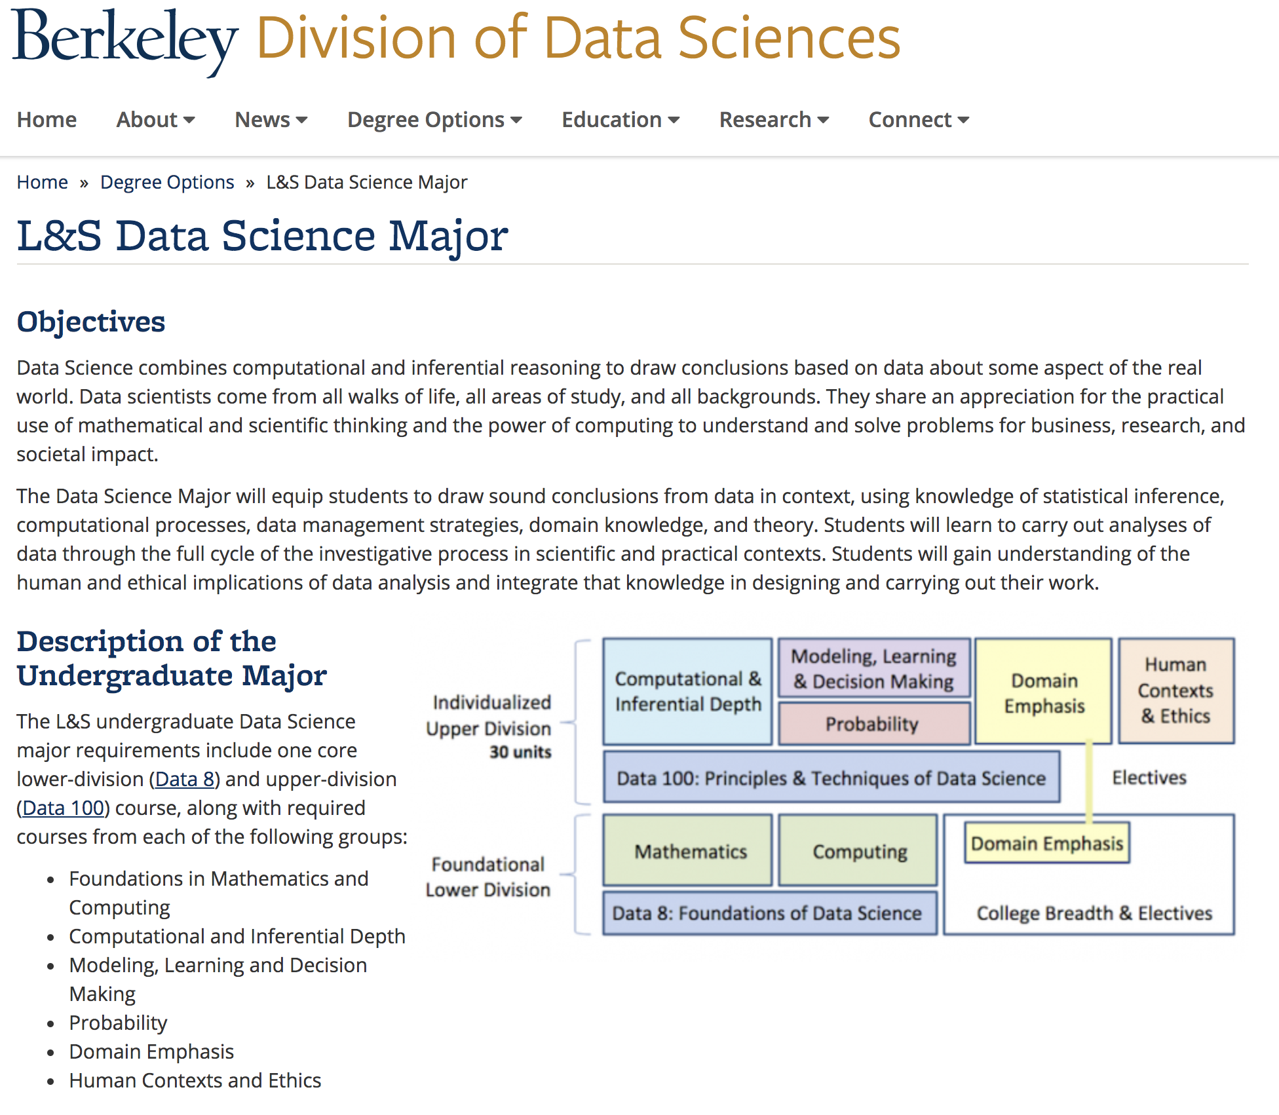
Berkeley’s New Data Science Major
https://data.berkeley.edu/degrees/data-science-ba

Slide 26
Why? Reason #2: Centrality
Data is at the center of modern society.
Unprecedented in its nature and significance
Particular and voluminous
Often asymmetric
low value in isolation, high value when aggregated
Difficult to protect
The infrastructure determines what’s possible

Slide 27
Why #3? The Core of Computing
Data growth will continue to outpace computation
Systems for Data at Scale: the core of modern computing

Slide 28
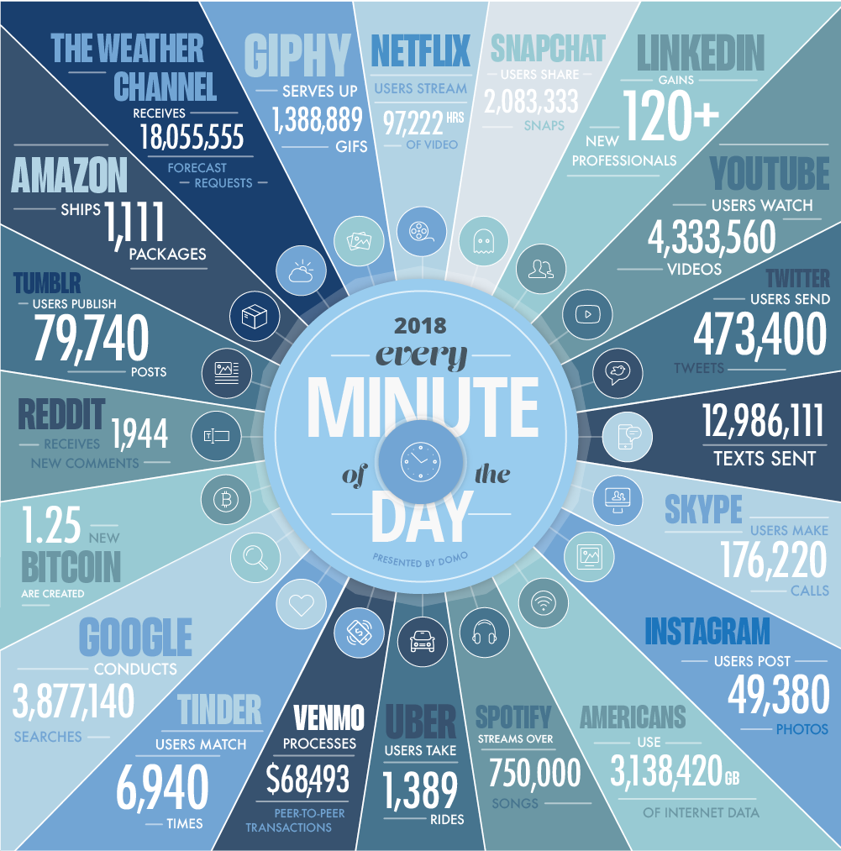
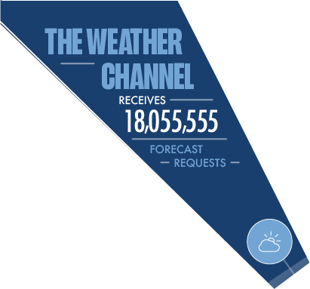
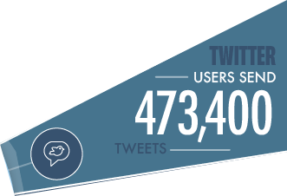
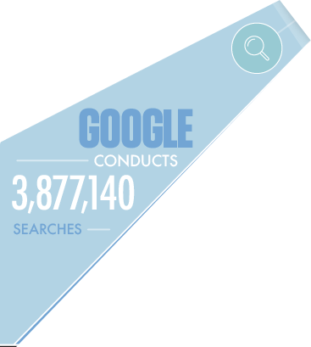
Every Minute!
https://www.domo.com/learn/data-never-sleeps-5

Slide 29
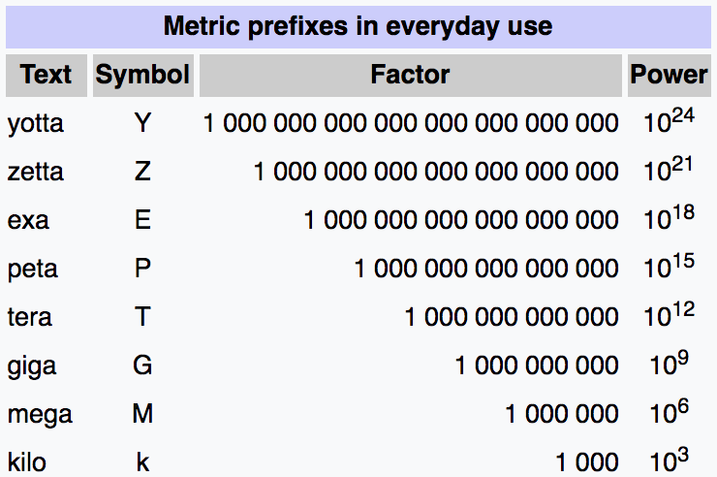
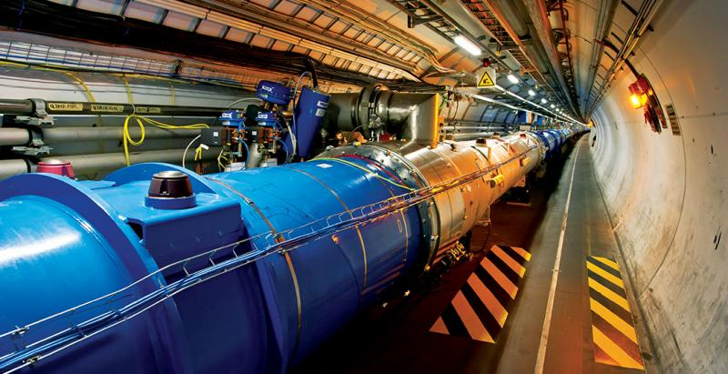
Scale of Scientific Data
Large Hadron Collider, CERN
Raw data: 1MB/event. 600,000,000 events/sec. = 1.9×10²² bytes/year = 19 ZettaBytes/year
Downsampled: 25GB/sec = 7.88×10¹⁷ bytes/year = 788 PetaBytes/year
Downsampled further: 1050MB/sec = 3.3*10¹⁶/year = 33 PetaBytes/year
https://home.cern/about/computing/processing-what-record

Slide 30


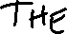
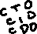
Forces Driving Data Growth
Ubiquitous sensors and reporting:
Cameras, mobile computing, social media, ...
Large collaborative science projects
Philosophy: More Data → More Value?
http://hyperboleandahalf.blogspot.com
Enabling Technology
Cheap, Scalable Data Management Systems
Notes:
http://hyperboleandahalf.blogspot.com

Slide 31
Why #3? The Core of Computing
Data growth will continue to outpace computation
Systems for Data at Scale: the core of modern computing
Techniques you learn in this class underlie many topics in computing

Slide 32
Essential Queries
Why take this class?
What is this class all about?
Who is running this?
How will this class work?

Slide 33
What is this class all about?
Databases?
What is a database?
Database Management Systems?

Slide 34
Universal Symbol for a Database

Slide 35
Why the Symbol?
Platters on a Disk Drive
Looks Like?

Slide 36
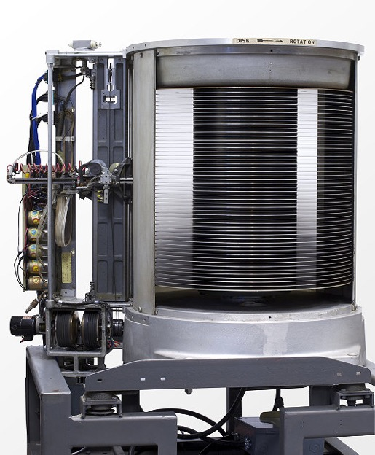
Why the Symbol?
1956: IBM MODEL 350 RAMAC
First Commercial Disk Drive
5MB @ 1 ton
Looks Like?
“...We must immediately...attack accounting problems under the philosophy of handling each business transaction as it occurs, rather than under the present condition of batching techniques....”
-- F. J. Wesley IBM Senior Manager
http://www.computerhistory.org/storageengine/first-commercial-hard-disk-drive-shipped

Slide 37
Is This a Database?
Rolodex
Alphbetically ordered cards
Indexed access by first letter

Slide 38
Is This a Database?
A database + “business logic” + user interface?
Most of Tinder’s value is the database itself.

Slide 39
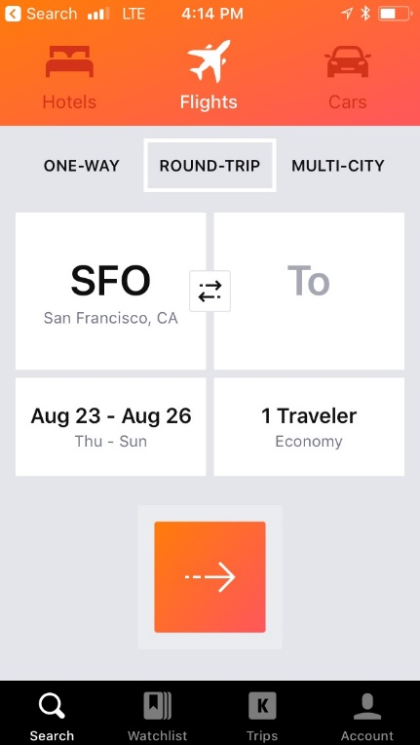
Is This a Database?
Airline reservation systems were one of the earliest pervasive consumer uses of database systems.
IBM/American Airlines’ SABRE system, 1964.
“Semi-Automated Business Research Environment”
Travelocity.com a direct descendant of SABRE
Acquired by Expedia, 1/2015

Slide 40
What is a Database?
Let’s not split hairs.
A database is a large, organized collection of data.
Sometimes confused with a Database Management System (DBMS)
A DBMS is software that stores, manages, and facilitates access to data.

Slide 41
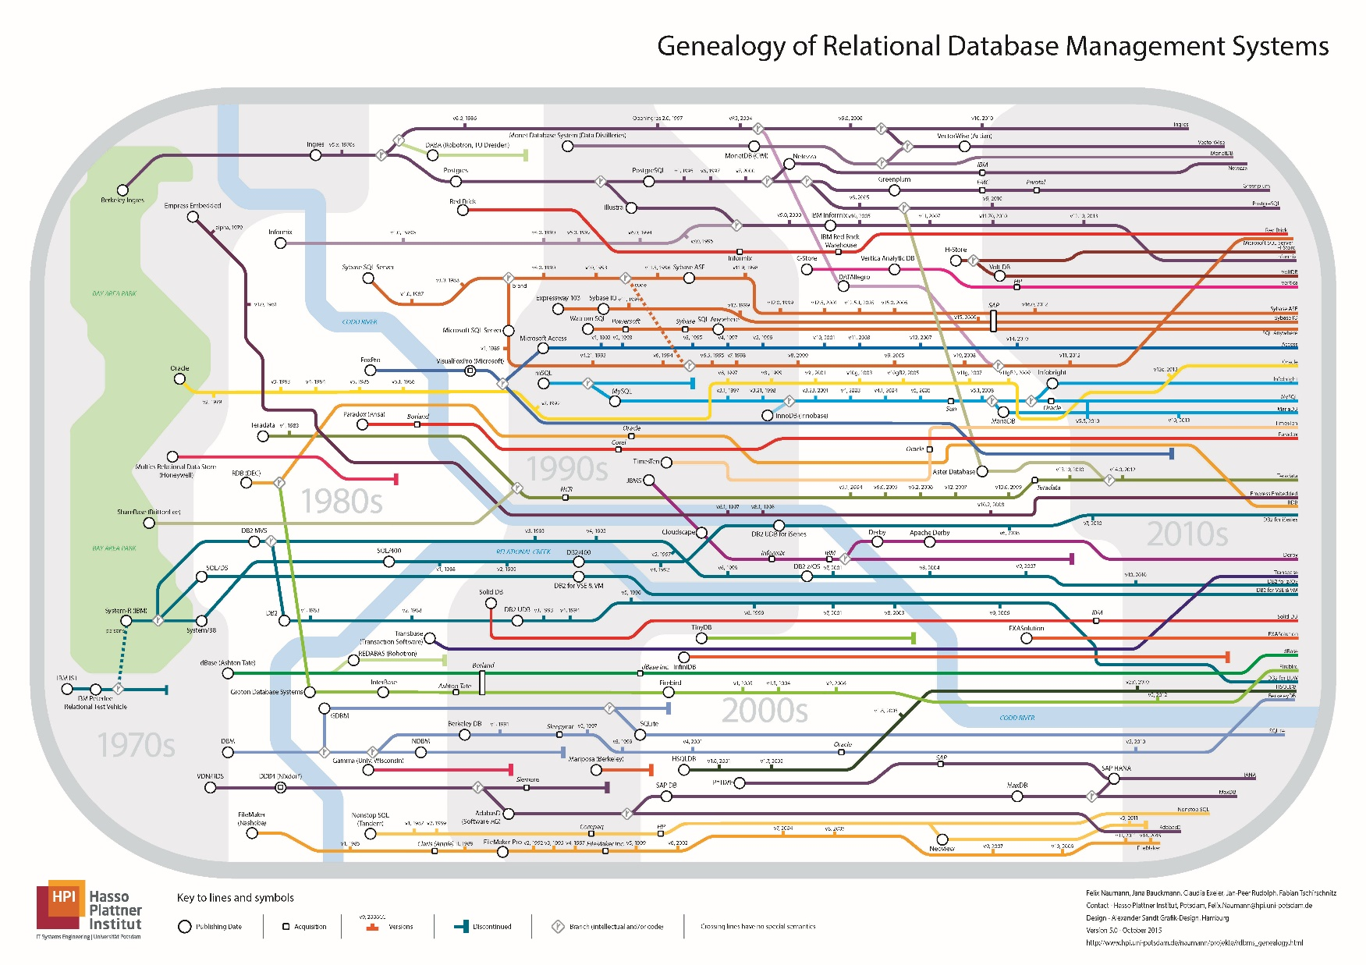
Berkeley Roots!
Ingres / Postgres
Sybase
Informix

Slide 42
Berkeley Roots!
Ingres / Postgres
Sybase
Informix
UC Berkeley
Oracle
IBM

Slide 43
Relational DBMSs
Traditionally DBMS referred to relational databases
RDBMS is a more appropriate term
SQL data description and manipulation language
ACID transaction consistency
Durable writes (prevent data loss)
Mature technologies …

Slide 44
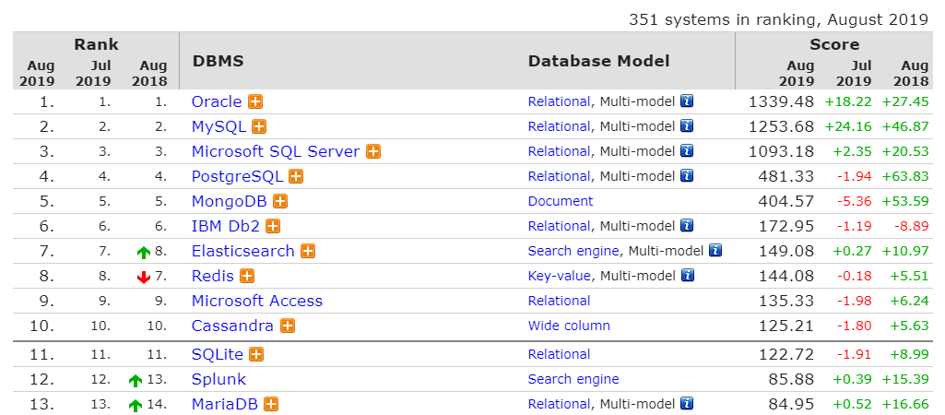
Ranking of DBMS Technologies 2019
Based on #mentions (e.g., stack overflow), google trends, job postings, profile data on LinkedIn, tweets …
http://db-engines.com/en/ranking

Slide 45
Relational Database Market
Big Market > 41B
http://www.infoworld.com/article/2916057/open-source-software/open-source-threatens-to-eat-the-database-market.html
Notes:
http://www.infoworld.com/article/2916057/open-source-software/open-source-threatens-to-eat-the-database-market.html

Slide 46
Relational Database Market
What is happening here?
Hadoop & NoSQL
Notes:
http://www.infoworld.com/article/2916057/open-source-software/open-source-threatens-to-eat-the-database-market.html

Slide 47
Market Trends
Cloud DBMS disrupting on-premises vendors
Cloud is less relational-centric
But fastest-growing services at AWS are RDBMSs
“One size doesn’t fit all”
Main-memory DBMS
Graph DBMS
TimeSeries DBMS
Key-Value Stores (NoSQL)
Analytics Platforms (Spark, Hadoop)
Tools for working with data
Business Intelligence (charting tools)
ML/Data Science platforms
Data preparation and next-gen data integration (ETL)

Slide 48
Reasons for Change
Hardware trends: RAM, SSDs, NVRAM, GPUs, …
Platform trends: cloud and elastic computing
Need to scale: storage and transactions
New data-types: text, json, image, video…
New workloads: machine learning & advanced analytics

Slide 49
Change = Opportunity!
The DBMS world is rapidly changing
Will discuss these changes towards end of the course
Our textbook is rather out of date (2003!)
Opportunity!
You can shape the future of DBMSs
We won’t follow the textbook slavishly.

Slide 50
Instead…
Focus: Foundational System Principles
Basic ideas and components
How to compose those components into a technology stack
Goal:
You will be able to use existing & build new DBMS technologies!

Slide 51
You will learn...
Data Oriented Programming with SQL (a la 61A)
Foundations of Data System Design
Storage, indexing
Query processing and optimization
Transactions
Concurrency, Consistency, Recovery
Data Modeling
Application-level representations of data

Slide 52
Principles
Data Independence
Declarative Programming
Rendezvous in Time and Space
Isolation and consistency
Data representations

Slide 53
Systems
We will examine various levels of a DBMS
Database Management
System
Query Parsing & Optimization
Relational Operators
Files and Index Management
Concurrency Control
Buffer Management
Recovery
Disk Space Management
Database

Slide 54
What is this class all about?
Databases?
What is a database?
Database Management Systems?
Implementation?
Big Ideas in Database Management Systems
Principles and Algorithms
System Designs
The heart of scalable CS

